Slide 1

Gamification of Time Management
2558994p
Sharon Padippurackal

Slide 2
Table of contents
01. Introduction
02. Background
03. Analysis
04. Design
05. Demonstration
06. Evaluation
What is the Problem?
What do we know already?
How can we tackle this?
What is the vision of our solution?
What is the final product?
How do we evalute our product?
06. Conclusion
What did we Learn?

Slide 3
01
Introduction
Slidesgo School
What is the Problem?

Slide 4

The Consequences of Poor Time Management and Procrastination
Effective time management is crucial for productivity and success, but it's often disrupted by procrastination.
Procrastination thrives on errors in scheduling, prioritizing, and carrying out tasks, leading to missed opportunities and unfulfilled aspirations.
Poor time management exacerbates procrastination, resulting in stress, missed deadlines, and decreased performance.
Statistics show that 80% to 95% of college students engage in procrastination, with roughly 75% self-identifying their procrastination. (Steel, 2007)

Slide 5

Motivation and Aims of the Study
Students frequently struggle with poor time management, leading to tardiness, missed deadlines, and academic performance decline.
Procrastination affects not only students but also the general population, resulting in financial losses and decreased well-being.
This study aims to combat procrastination by developing an effective gamified time management solution.
The goal is to revolutionize time management, mitigate the adverse effects of procrastination, and enhance productivity and overall well-being.

Slide 6
—Diane Ackerman
Slidesgo School
“Play is our brain's favorite way of learning.”

Slide 7

Integration of Gamification in Time Management
Gamification has shown promise in various fields, including healthcare, by improving self-management and adherence.
However, its application in time management remains underexplored, presenting an opportunity for innovative interventions.
The gaming industry's growth and recognition of gamification's impact on behavior change create a promising landscape for transformative outcomes.
This study proposes a framework that seamlessly integrates gamification and behavioral change principles to enhance time management skills.

Slide 8
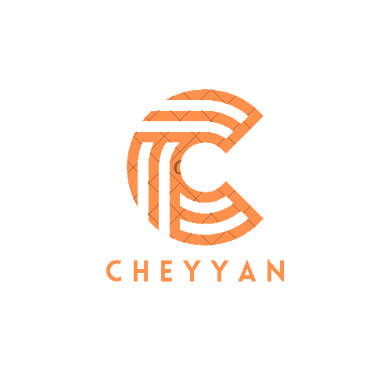
Cheyyan: A Gamified Time Management Solution
To address procrastination and poor time management, we developed Cheyan, a Flutter-based task management system with gamification features.
Cheyan incorporates game elements such as point systems, challenges, and rewards to make task management engaging and motivating.
The goal is to empower users, especially young adults, to take control of their time, develop motivated routines, and improve productivity.
Through the fusion of Flutter technology and gamification elements, Cheyyan provides an effective solution for optimizing time management skills in an engaging manner..

Slide 9
Specifics Aims
Provide Cheyyan, a student-focused gamified time management tool, incorporating game elements to make repetitive activities exciting and encourage consistent effort.
Evaluate whether Cheyyan helps students improve time management skills through increased application usage, better time management practices, and potentially enhanced academic performance.
Analyze user experience and engagement with Cheyyan through qualitative analysis of user feedback to understand its effectiveness in improving time management skills.

Slide 10
02
Background
What Is has been Done?

Slide 11
Related Products
Pure Time Managemnt
Pomodoro Technique
Pure time management applications focus on scheduling strategies and organizational effectiveness to increase user productivity.
Features include task management, calendar integration for scheduling, reminders for upcoming tasks or deadlines, and time tracking to observe time utilization patterns.
Examples of pure time management tools include Google Calendar, Microsoft To Do, and Evernote.
Pomodoro Technique applications are designed to be used with the Pomodoro Technique, a time management strategy based on work intervals and short breaks.
These apps incorporate gamification aspects to support the Pomodoro Technique, including timer integration for work sessions and breaks, visual cues for progress tracking, and statistics tracking for self-awareness and improvement.
Examples of Pomodoro Technique apps include Focus Keeper, PomoDone, and Clockify.

Slide 12
Related Products
Gamified Apps
Gamified apps in the time management space use game mechanics to enhance user motivation and engagement.
Features include complex incentive systems with points, badges, or virtual prizes, challenges for individual or group participation, and character advancement through task completion.
Notable examples of gamified apps include Habitica, Forest, Workpack, and SuperBetter.

Slide 13
Project Foundations

Slide 14
Gamification
Conceputal Framework
Justification
Cheyyan employs gamification, deliberately using game elements in non-gaming contexts.
The purpose is to make time management tasks captivating experiences, increasing motivation, engagement, and commitment.
Empirical findings support gamification's effectiveness in improving learning outcomes and altering behavior.
Unique gamified components like quests, character development paths, and awards make Cheyyan engaging and fun.
Research suggests gamification increases intrinsic motivation, making time management a pleasurable experience.
Cheyyan's design is based on the gamification conceptual framework, consistent with research on the transformational power of gamification.

Slide 15
Goal Setting and Self-Efficacy
Conceputal Framework
Justification
Self-efficacy and goal-setting are crucial psychological concepts in Cheyyan.
Self-efficacy refers to a person's confidence in their capacity to carry out activities successfully.
Goal setting involves selecting precise targets and developing strategies to achieve them.
Psychological research supports the significance of self-efficacy and goal setting.
Bandura's Social Cognitive Theory emphasizes the critical role of self-efficacy in motivation and accomplishment.
Locke and Latham's Goal Setting Theory highlights the importance of clear, difficult, and reachable objectives in boosting motivation and performance.

Slide 16
Positive Reinforcement
Conceputal Framework
Justification
Cheyyan's operational paradigm is centered around the psychological principle of positive reinforcement.
Desired behaviors are strengthened when they result in favorable outcomes.
Cheyyan uses rewards and positive feedback to reinforce effective time management habits.
Based on B.F. Skinner's theory, actions resulting in positive outcomes increase the likelihood of repetition.
Positive reinforcement has been shown to modify behavior effectively in various settings.
Cheyyan leverages real-world awards and positive feedback to enhance motivation and user engagement.

Slide 17
03
Analysis
Slidesgo School
How can we tackle this?

Slide 18
Analysis
User Stories
User Scenarios
It provide a user-centric perspective by outlining the "who," "what," and "why" of user interactions
It provides comprehensive narratives that describe how users interact with the system in particular situations

Slide 19
Analysis
Functional Requirements
Non-Functional Requirements
Core Features for Cheyyan
Ensuring Reliability and Performance

Slide 20
04
Design
What is our Vision of our Process?

Slide 21
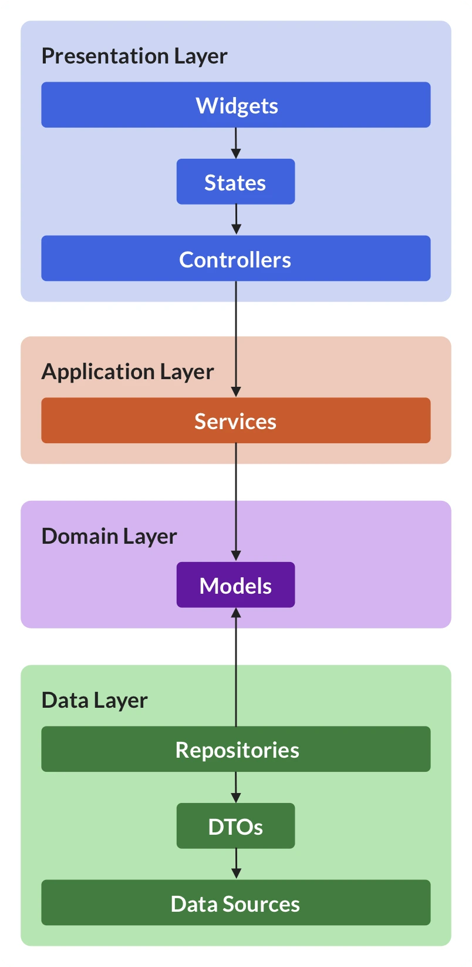
System Architecture

Slide 22
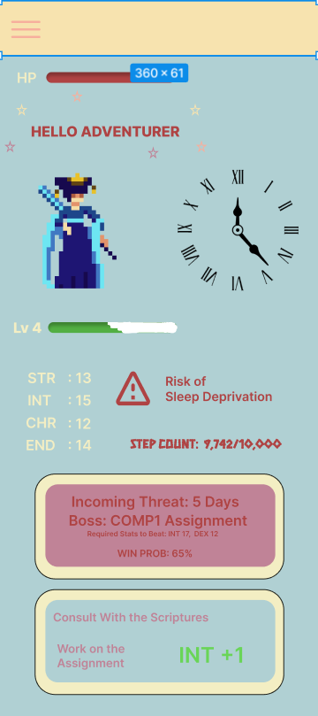
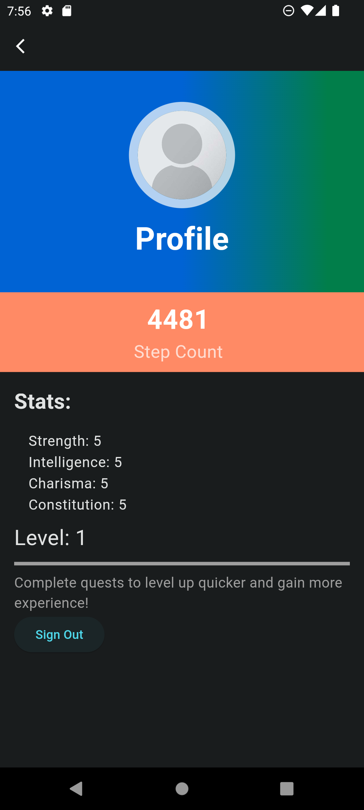
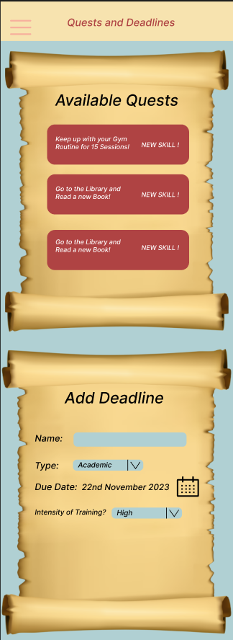
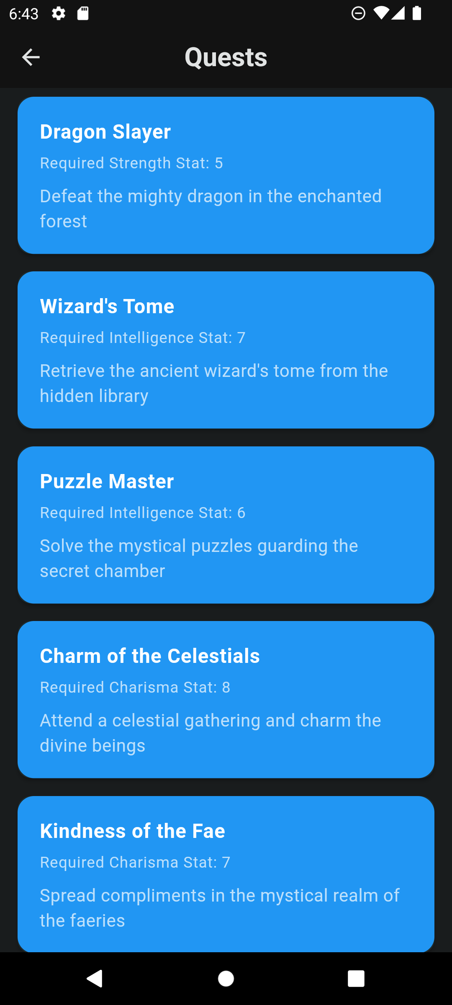
WireFrames – Final Design

Slide 23
05
Demonstration
Slidesgo School
What is our final Product?

Slide 24

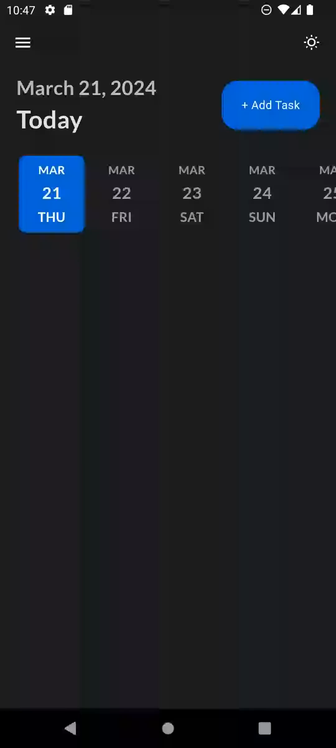
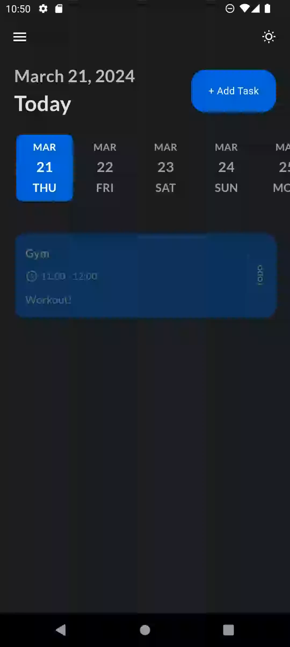
Demonstration

Slide 25
06
Evaluation
How well did our product do?

Slide 26
Evaluation
Methodology
Justification
Structured survey designed to gather insights on user experience.
Covered various aspects: app navigation, task management, quest completion, reward system, app performance, overall satisfaction.
Aimed for comprehensive understanding without overlooking crucial components.
Survey chosen for scalability, standardization, anonymity, ease of administration, and accessibility.
Enabled gathering both qualitative and quantitative data for thorough analysis.
Allowed learning about usability, functionality, and user satisfaction of Cheyyan.

Slide 27
Evaluation
Results
Future Work
Navigation and Task Management:
Majority found app easy to navigate.
Adding tasks perceived as easy; suggestions for additional fields.
Quest Completion and Reward System
Varied feedback on quest completion; concerns about reward appropriateness and redemption issues.
App Performance and Bugs
Positive ratings for app performance; occasional reports of lag or crashes.
Long-term Usage and Productivity Impact
Willingness expressed for long-term use; positive feedback on productivity impact.
Technical Optimization and Issue Resolution: Priority on resolving technical issues.
Quest Clarity Enhancement: Improve quest clarity and instruction precision.
Refinement of Reward Mechanisms: Review and improve incentive system.
Including Extra Task Management Functionality: Add features to meet diverse user demands.

Slide 28
Conclusion!
Cheyyan!

